Slide 1
Classification and Text Analysis of Public Comments to Proposed Rules
Arthur Pignotti
Health Insurance Specialist
Centers for Medicare & Medicaid Services (CMS)
Medicare Plan Payment Group
arthur.pignotti@cms.hhs.gov
INFORMATION NOT RELEASABLE TO THE PUBLIC UNLESS AUTHORIZED BY LAW:
This information has not been publicly disclosed and may be privileged and confidential. It is for internal government use only and must not be disseminated, distributed, or copied to persons not authorized to receive the information. Unauthorized disclosure may result in prosecution to the full extent of the law.
Notes:
Hello, my name is Arthur Pignotti. I’m a health insurance specialist at the Centers for Medicare and Medicaid Services or CMS, working on Medicare Part C and D plan payment policy. Part C or the Medicare Advantage program is where CMS pays capitated payments to private insurance plans to cover medical costs for beneficiaries. Part D is the prescription drug coverage portion of Medicare. My project was to create a process for classifying and analyzing public comments to documents posted on regulations.gov.

Slide 2






Background on Comment Review Process
Post Proposed Rule
Receive Public Comments
Sort & Review Comments
Brief Leadership & Get Decisions
Write & Publish Final Rule
Period can be as short as 30 days
Notes:
First, I’m going to provide some background on the comment review process. For those of you who live and breathe this process, just indulge me for a minute before deciding to fall asleep. First, a document for public comment is posted to regulations.gov. Then, for a specified amount of time, the public is able to post comments to the document. These comments can be anything from a one-sentence statement to a 100-plus page monograph. After the comment period is over, subject matter experts or SMEs will sort, review and analyze the comments. Then they will brief leadership and get policy decisions. With these decisions, they will write and publish the final rule. That does not sound too bad, right? Well, the issue for many of us at CMS is that many of these documents are related to payment and so are bound to payment cycles and timelines. So, in many cases we have as few as 30 days from the end of the comment period to the publishing of the final document. Now, you may be sitting there thinking, but can’t you review comments during the public comment period to save time? Well, like students handing in term papers, most commenters submit their pages of comments right before the deadline.

Slide 3



Customer Need: Automate Tasks to Spend More Time on Complex Tasks
Reduce the Time to Sort, Read, and Analyze +1,000 Pages of Comments, Mostly in PDF Form
Quickly Brief Leadership to Maintain Tight Deadlines
Ease the Workload of Follow-On Analyses While Writing Final Rule
Notes:
So, what are the needs of the stakeholders in this process? In a nutshell, they need the tedious tasks automated so they can spend more time on the complex tasks like synthesizing, briefing, and writing. To do this, we need to reduce the time to sort, read, and analyze over a thousand pages of comments, mostly in PDF form. This will allow them to brief leadership sooner, which will help maintain tight schedules and make deadlines. Also, for more complex decisions, SMEs need to provide follow-on analyses to answer leadership’s questions before decisions can be made. This is done normally while SMEs are writing parts of the final document so easing some of this analytical workload is needed as well.

Slide 4


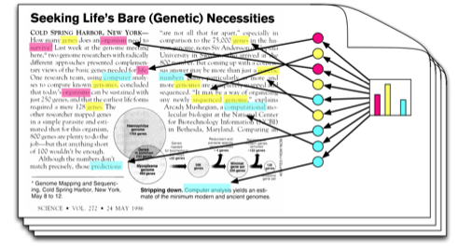
Solution: Topic Modeling Process to Automate Tedious Tasks
Use Proposed Rule Text to Train Topic Model
Automate the Conversion of Comments into Machine Readable Text
Use Topic Model to Classify Public Comments by Proposed Rule Section
Notes:
A solution to these problems is creating a topic modeling process to automate tedious tasks like classifying and converting comments. The first step in this process is to use the text from the proposed rule to create a topic model.

Slide 5
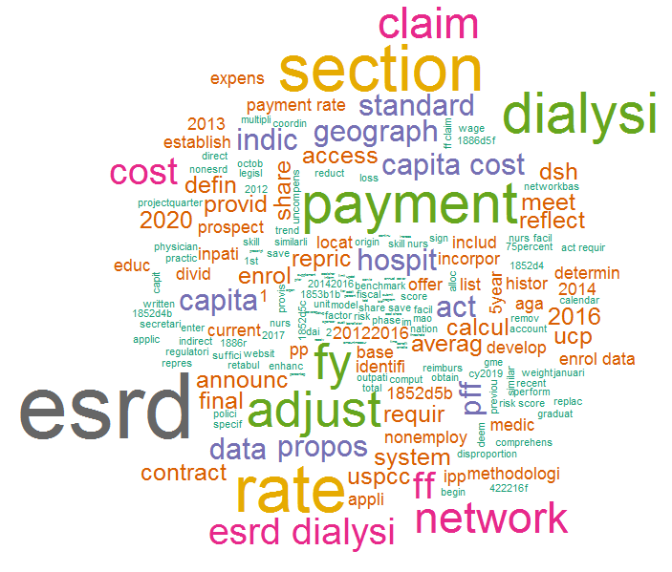
What is a Topic Model
Example Topic: ESRD Rates
Notes:
Lets take a quick step back. What is a topic model? A topic model basically builds topics by grouping significant, correlated words together. If that did not make sense, here is a concrete example. Say we have a section about ESRD rates. In that section, words like ESRD and dialysis will show up often and uniquely since other sections will most likely not use these words. Therefore, among the topics that the model creates, there will be one where these words are heavily weighted as you can see in the example on the left. On the right, is a graphic that the algorithm creator designed. For our purposes, I will this to illustrate how comment classification works. Imagine that this is a comment and each color represents a topic. The algorithm will search the comment for instances of terms from different topics. Each time a word from a topic appears, the probability that the comment discusses that topic increases until we have final probabilities. Now, back to the larger process.

Slide 6
Solution: Topic Modeling Process to Automate Classification Tasks
Use Proposed Rule Text to Train Topic Model
Automate the Conversion of Comments into Machine Readable Text
Use Topic Model to Classify Public Comments by Proposed Rule Section
Notes:
We have trained our topic model. Next, there is a program to automate the conversion of comments into machine readable text that can be used by the topic model. Then input the comments into the topic model and it will classify comments by assigning them probabilities for each section. So, going back to our example, if a comment says ESRD and dialysis numerous times, it will receive a high probability for that section and probably very low probabilities for other sections.

Slide 7
Example Output
Comment ID | Text | Link | Section A | Section B | Section C | Section D | Section E
Rule#-0001-0-1 | Lorem ipsu… | C:\Comm… | 0% | 0% | 2% | 0% | 18%
Rule#-0002-0-1 | dolor sit… | C:\Comm… | 0% | 0% | 100% | 0% | 0%
Rule#-0003-0-1 | amet, muc… | C:\Comm… | 0% | 75% | 0% | 0% | 92%
Rule#-0003-1-1 | copiosae pr… | C:\Comm… | 0% | 0% | 0% | 0% | 0%
Rule#-0004-0-1 | an, eos mei… | C:\Comm… | 0% | 0% | 0% | 0% | 0%
Rule#-0004-1-1 | sensibus te… | C:\Comm… | 98% | 0% | 0% | 92% | 0%
Rule#-0004-1-2 | Et quem… | C:\Comm… | 0% | 0% | 95% | 0% | 0%
Rule#-0004-1-3 | omittantur… | C:\Comm… | 0% | 0% | 0% | 4% | 0%
Rule#-0004-1-4 | liberavisse… | C:\Comm… | 0% | 0% | 0% | 97% | 0%
Rule#-0004-1-5 | Nihil dicant… | C:\Comm… | 2% | 84% | 0% | 0% | 88%
Rule#-0004-1-6 | cetero an… | C:\Comm… | 0% | 0% | 0% | 0% | 0%
Rule#-0004-1-7 | nam, liber… | C:\Comm… | 0% | 0% | 0% | 0% | 0%
Rule#-0004-1-8 | Nonumy lab… | C:\Comm… | 0% | 0% | 0% | 0% | 95%
Notes:
Here is an example of the output that SMEs would receive. It has the comment ID, the text from the comment, a link to the comment and a column for each section of the proposed rule with probability scores that the comment discusses that section. If the model is working well, the scores should be bimodal, meaning, in this case, that most scores are either near 0 or 100%. Now, what SMEs can do with this is sort the document by their section’s results and work their way through the list.

Slide 8
Benefits to Stakeholders
Automate tedious tasks so we can allocate more time important tasks
Briefing sooner can mean earlier decisions and maintaining timelines
More time to analyze arguments on tougher decision points
Outputs from the process can be used as inputs
Comment counts by industry by topic
Possible sentiment analysis

